Slide 1
NETFLIX DASHBOARD
Presented BY : Ruchika Thorat.

Slide 2

Problem Statement :
Netflix has a huge library of Movies and TV Shows.
Understanding content distribution manually is difficult.
Need to analyze movies vs. TV shows, genres, ratings, and countries.
Hard to Track trends of movies releases by years.
A dashboard is required to visualize these insights clearly.

Slide 3
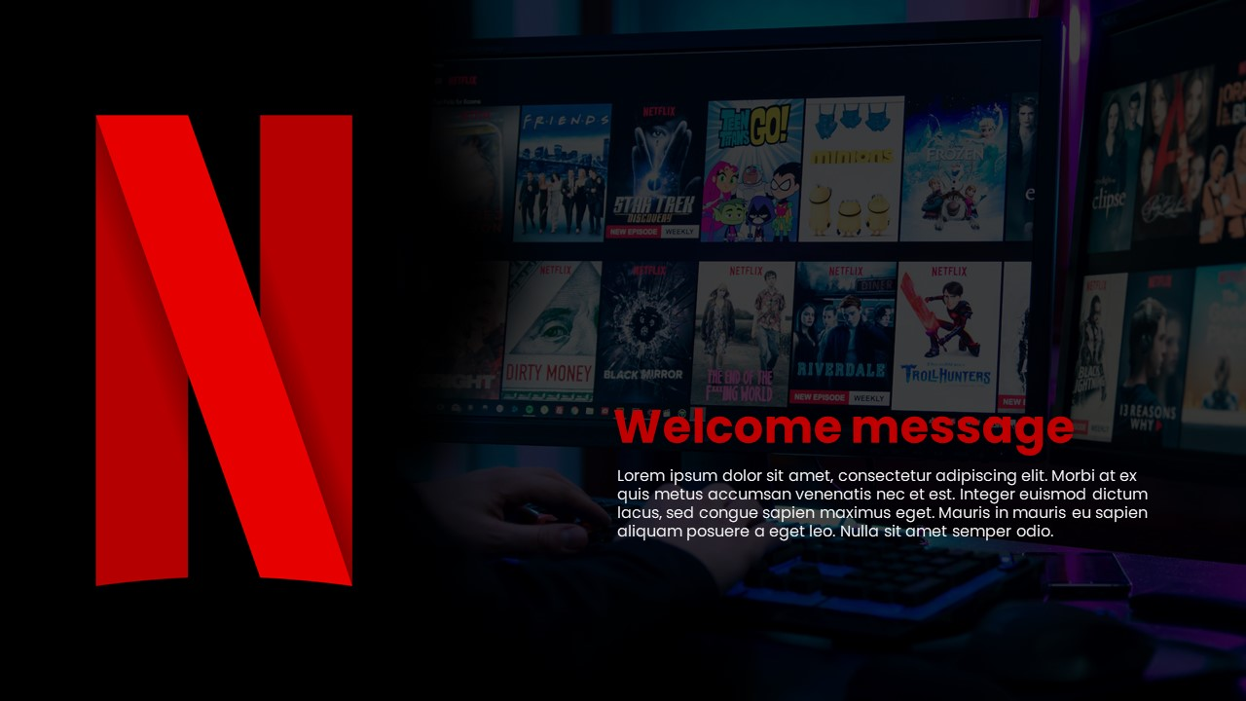
Dataset Information :
Dataset Name : Netflix.titles
Source : Public Dataset Kaggle
The dataset contains information about Netflix Movies and TV Shows.
Key columns include:
Show Id
Type (Movie or TV Show)
Title
Director
Cast
Country
Release Year
Rating
Duration
Genre (Listed In)
Date Added
Discriptiom
The dataset helps analyze content distribution across countries, genres, ratings, and years.

Slide 4
⭐ Suggested Visuals :
Cards Visuals : Date Added ,Duration ,Rating ,Genre ,Description , Release Year.
Map Chart : Map Chart shows the total Movies and TV Shows by country, using darker colors to highlight countries with more titles.
Column Chart : The Column chart compares rating categories by height, showing which rating appears most frequently.
Bubble Chart : Shows how Movies and TV Shows are distributed, with bubble size indicating the number of titles.
Bar Chart : Displays the top 10 genres based on the highest number of titles.
Line Chart : Shows the total number of movies released each year, highlighting the yearly trend.
Slicers : Included slicers for Type and Title to make the dashboard more interactive.

Slide 5
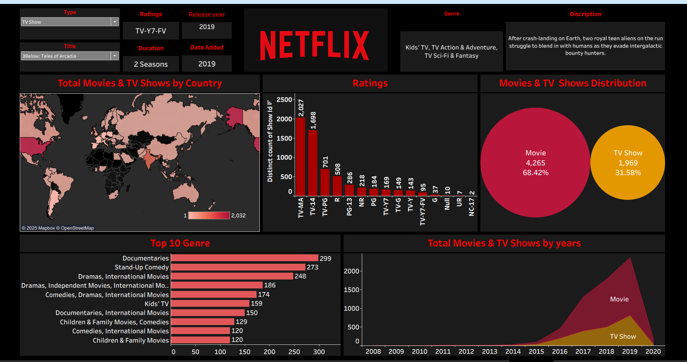
Dashboard :

Slide 6
  Insight :
USA, India, and the UK produce the most titles, highlighted in darker shades on the Map Chart.
Column Chart shows TV-MA and TV-14 are the highest ratings.
Bubble Chart shows movies (68%) are more than TV shows (32%).
Bar Chart shows Documentaries and Stand-Up Comedy are the top genres.
Line Chart shows content increased a lot after 2015 and TV shows are growing but still less than movies.”
Conclusion :
Netflix has more movies than TV shows, and most content was added after 2015. The platform has many different genres and ratings. Overall, Netflix’s content library is big, growing fast, and comes from many countries.”

Slide 7
THANK YOU

